Slide 1
Assembly, N_{E} and Sex Marker(s)
01 March 2021
Shannon EK Joslin
Slides:
https://github.com/shannonekj/presentations/raw/master/2021_02-SWC/ assembly-ne-sex.pptx

Slide 2
Historical datasets
2208 wild fish from 1993 – 2016
RAD sequencing for each fish
Gives you data roughly every 65,000 base pairs
Initial de novo assembly using RAD sequencing
Used for first estimates of effective population size
48 visually sexed fish
RAD sequencing for each fish (used different protocol to get sample from more locations throughout genome)

Slide 3
New data…!
420 wild fish from 2017 – 2019
RAD sequencing for each fish
Third generation sequencing data
Linked-reads
Long reads
j

Slide 4
Effective Population Size (N_{E}) – quick background
Definition: the number of individuals that an idealized population would need to have in order for a specified quantity of interest to be the same in the idealized population as in the real population
Specified quantities of interest have different uses
Can look at historical (Watterson’s & Pi ) or contemporary (Jorde & Ryman, Nei & Tajima, and Pollak) N_{E} as
Historical N_{E} is usually fairly stable
Contemporary N_{E} can give the effective population size of just a few generations back
Notes:
Historical Ne is fairly stable unless there is a massive alteration to a population

Slide 5
Historical Ne

Slide 6
Contemporary Ne
Notes:
Esitmates get smaller and have error bars as we approach more recent generations
We might expect this if a population shrinks

Slide 7
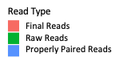
How much information did we glean?
Birth Year | Average Alignment | Birth Year | Average Alignment
1993 | 35.3% | 2007 | 80.8%
1995 | 74.5% | 2008 | 80.8%
1996 | 69.6% | 2009 | 79.7%
1997 | 65.7% | 2010 | 78.0%
1998 | 70.7% | 2011 | 77.7%
1999 | 74.0% | 2012 | 77.7%
2000 | 70.3% | 2013 | 77.0%
2002 | 81.4% | 2014 | 77.6%
2004 | 81.2% | 2015 | 78.8%
2006 | 80.9% | 2016 | 78.7%
 |  | All Years Combine | 78.0%
Notes:
Something that may lead to technical issues is that we are not getting all of the information that we can from our data. We can only use markers that align in all individual and here you can see that alignments rates are fairly low
–– over 20% of reads didn’t align to our de novo RAD seq based assembly

Slide 8
Get a better assembly
Use more current sequencing technology to create a chromosome-scale hybrid assembly
long reads
hi-c
linked reads

Slide 9
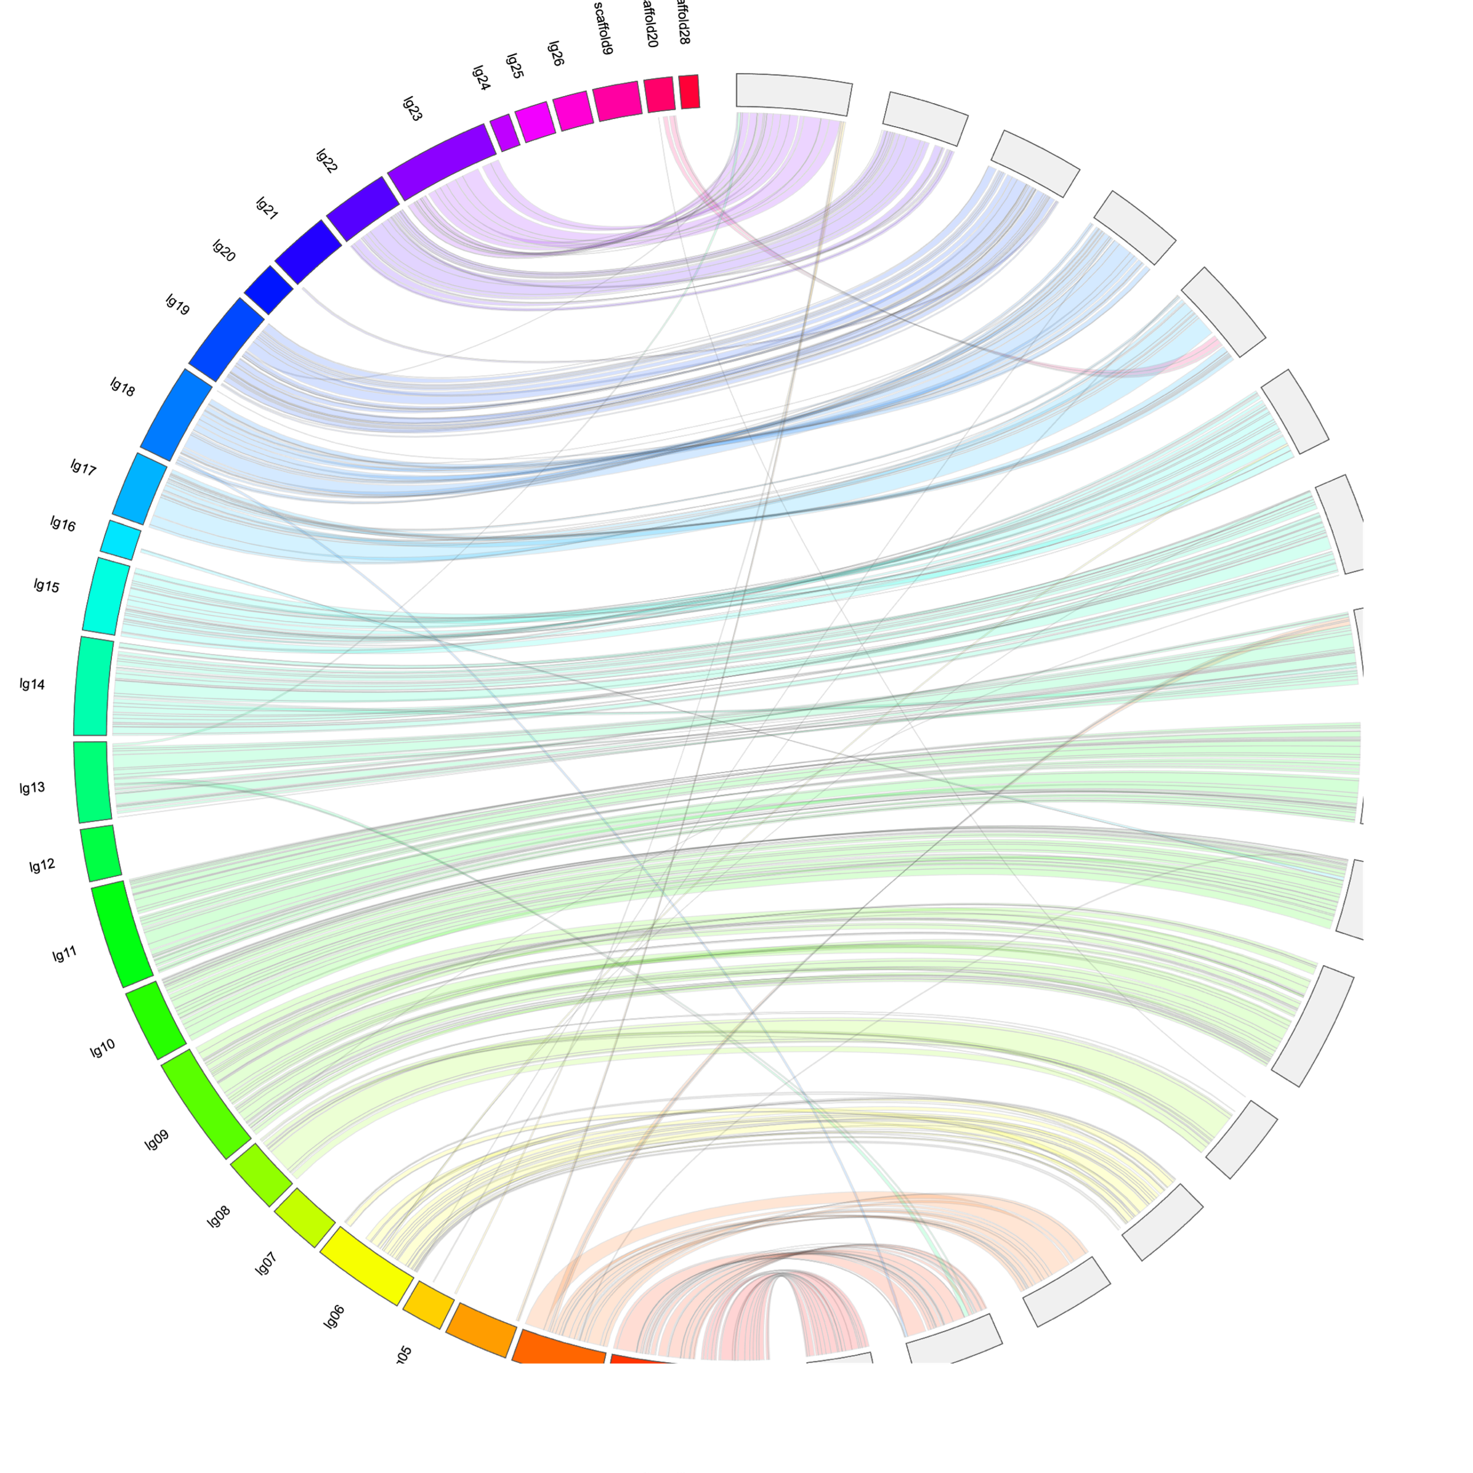
We achieved two high quality assemblies
One Male
One Female
Both assist in validating each other

Slide 10
Comparison metrics
 | RAD Assembly | Hybrid Assembly (female)
Assembly Length | 12,905,745 bp | 437,273,953 bp
% of Estimated Genome | 2.58% | 94.4%
Average Scaffold Length | 472 bp | 1,162,963 bp
Number of Scaffolds | 27,297 | 376

Slide 11
Better alignments
 | Average Alignment
All Years Combine | 92.6%
Better estimates…?

Slide 12
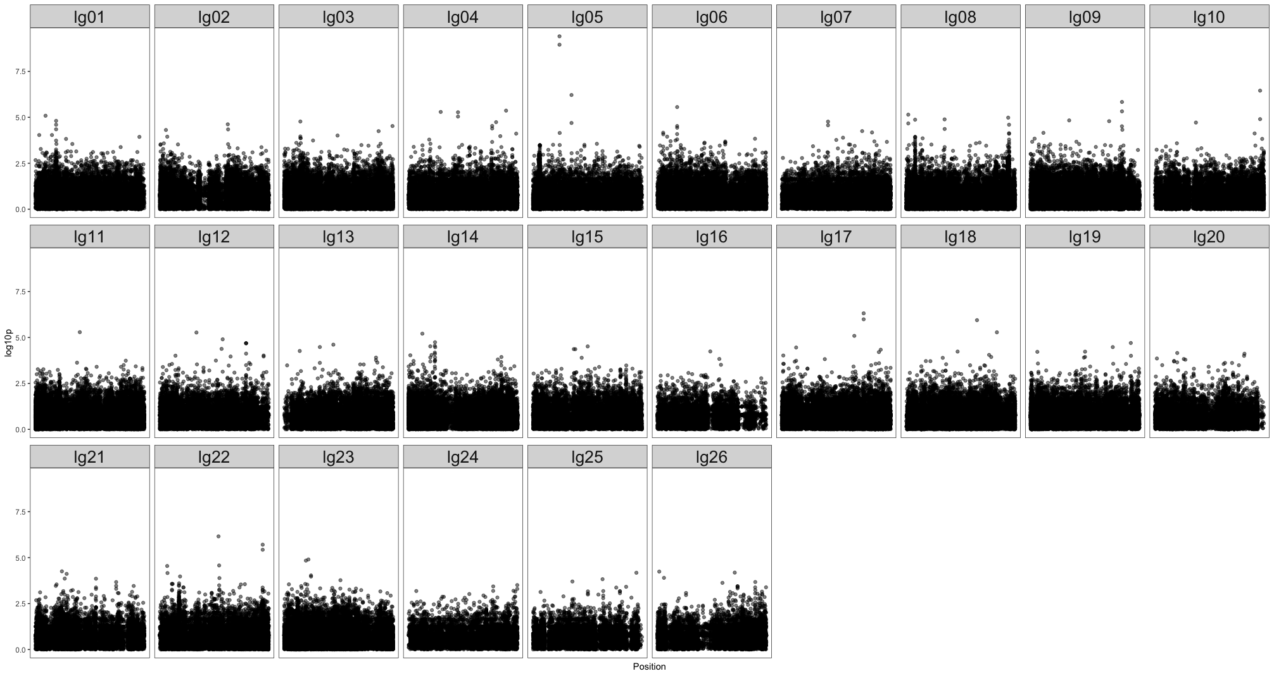
Sex marker

Slide 13
Questions?

Slide 14
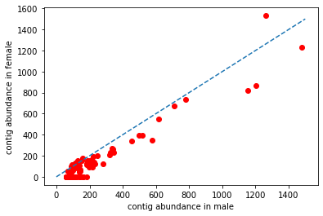
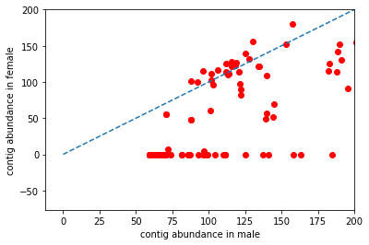
Sex marker

Slide 15
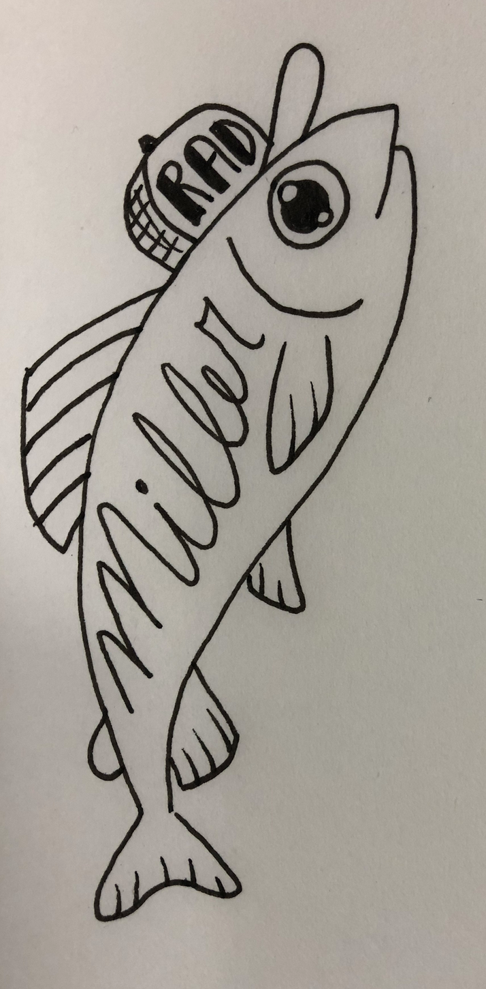

Thank you!
Genomic Variation Lab
Miller Lab
Mandi Finger
Alisha Goodbla
Ismail Saglam
Titus Brown
Mike Miller
Andrea Schreier
Melinda Baerwald
Ted Sommers

